Slide 1
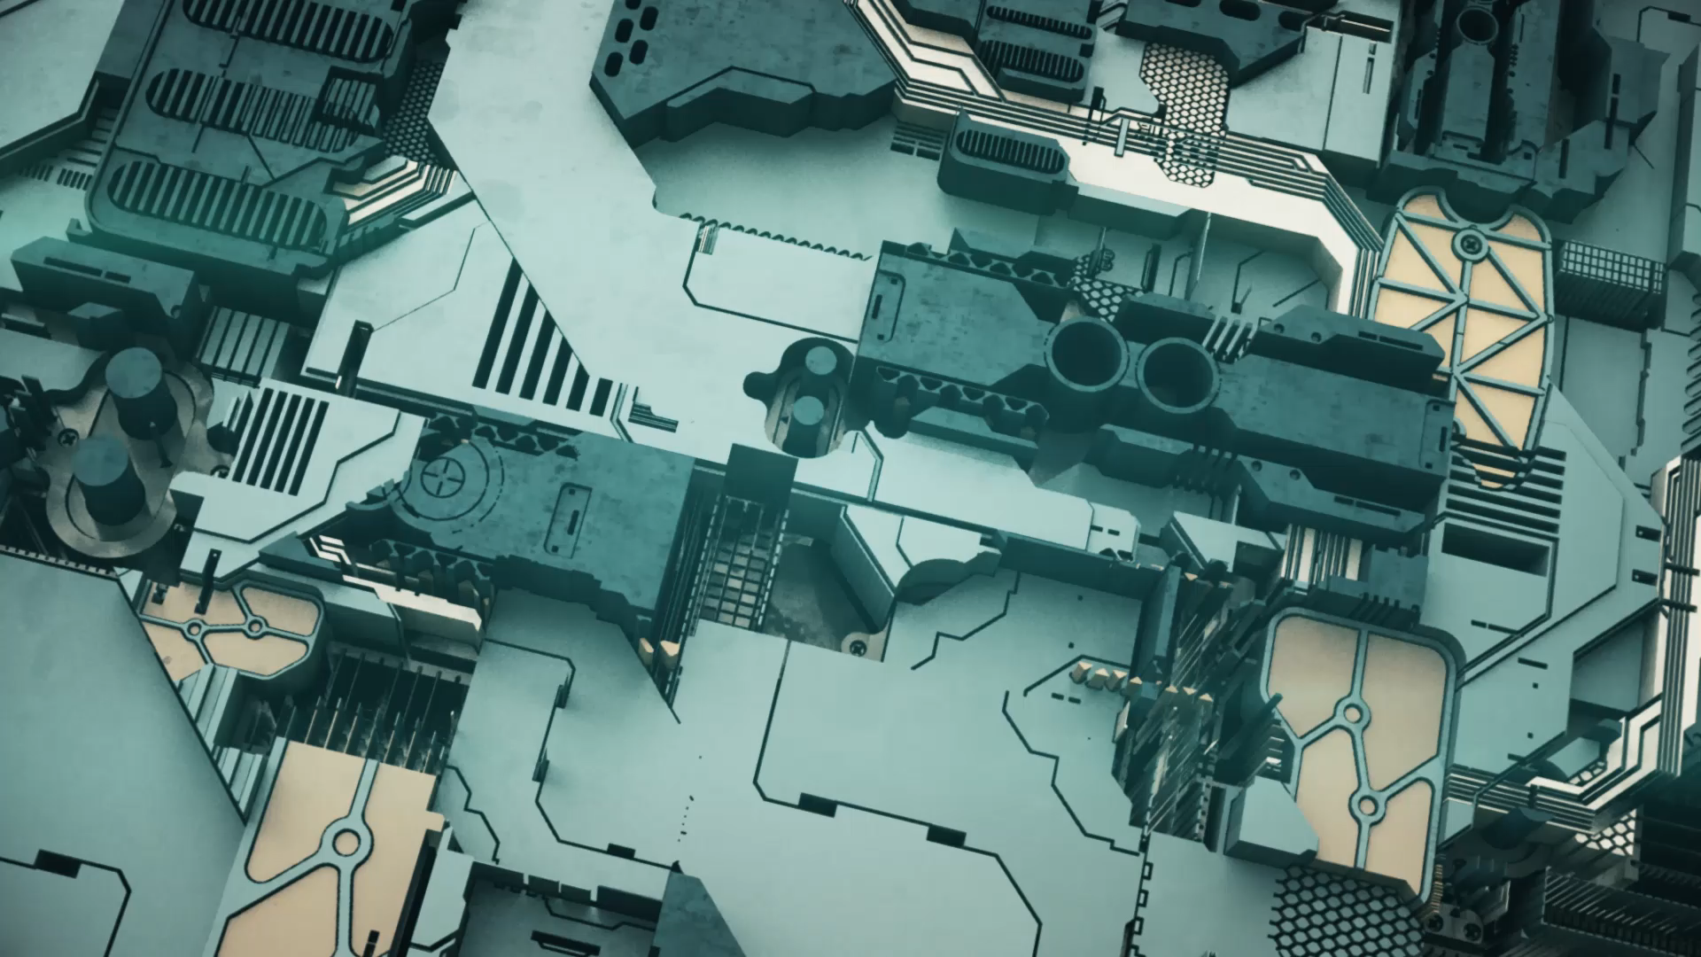
Architectural Design Pattern: Model-View-Controller
Muhammad Talah Khan FA20-BSE-042
Fahad Farman FA20-BSE-044

Slide 2

Intent
The intent of this design pattern is to help keep the user interface separate from the rest of the program.
or
The primary intent of MVC is to provide a clear separation of concerns within an application, enabling:
Modularity and Reusability
Scalability and Maintainability
Parallel Development
Testability
Notes:
Modularity and Reusability: Each component can be developed and maintained separately, promoting code reusability and easier modification without affecting other parts of the application.
Scalability and Maintainability: MVC's structure allows for easier scalability as new features can be added without major changes to the existing codebase. Additionally, it enhances maintainability by isolating changes within specific components.
Parallel Development: Different teams or developers can work on different parts (model, view, or controller) simultaneously without interfering with each other's work.
Testability: Separating concerns allows for easier testing of individual components, facilitating unit testing and ensuring robustness and reliability of the application.

Slide 3
Applicability
Web Development: MVC is extensively used in web applications due to its ability to separate concerns. Frameworks like Ruby on Rails, Django, ASP.NET MVC, and others employ MVC to structure server-side code, manage data, and handle user interactions via web interfaces.
Desktop Applications: MVC can be applied to desktop software development, enabling the separation of the user interface (View) from the application logic (Model) and user input handling (Controller). This separation simplifies maintenance and updates.
Real-time Applications: Applications requiring real-time updates or synchronization benefit from MVC's ability to separate data handling and presentation, allowing for efficient updates to the user interface based on changes in the data model.
API Design: In designing APIs, MVC concepts can be valuable in structuring endpoints, data models, and controller logic, providing a clear separation

Slide 4
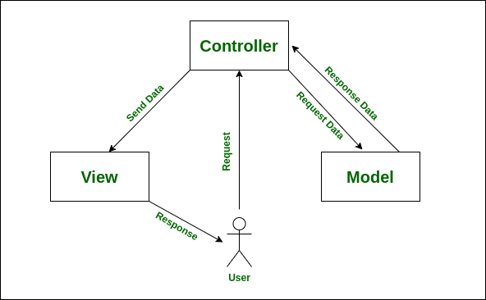
Structure Diagram

Slide 5
Participants
Model:
Represents the application's data and business logic.
Manages the data and responds to requests for information about its state.
Notifies the View of any changes in the data.
View:
Handles the presentation layer and the user interface.
Displays the data from the Model to the user in a specific format.
Receives user input (indirectly through the Controller) for further processing.
Controller:
Acts as an intermediary between the Model and the View.
Receives user inputs directly.
Manipulates the Model based on user inputs and updates the View accordingly.

Slide 6
Consequences
Although it has been very widely used for some time, the MVC does have some shortcomings:
Its emphasis is on data: Instead of asking an object to do something with its data, the View asks for the data and then displays it, which can also contribute to inefficiency.
Tight coupling: Both View and Controller are tightly coupled to the Model's public interface.

Slide 7
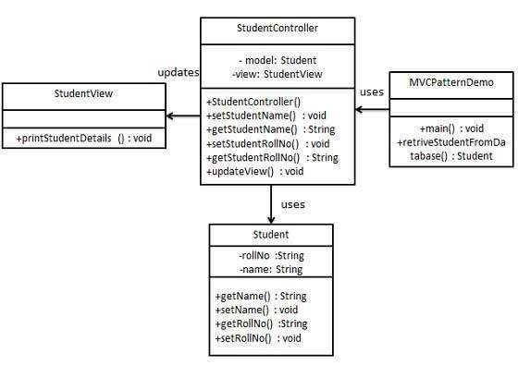
Base Example Implementation
We are going to create a Student object acting as a model.
StudentView will be a view class which can print student details on console.
StudentController is the controller class responsible to store data in Student object and update view StudentView accordingly.
MVCPatternDemo, our demo class, will use StudentController to demonstrate use of MVC pattern.

Slide 8
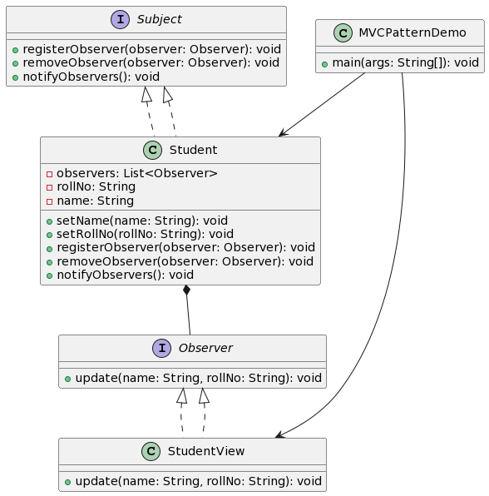
RealWorld1 Example Implementation
Suppose our application now requires not just one view but multiple views to display student details. We'll implement the Observer pattern to notify all registered views whenever there's a change in the student's data.

Slide 9
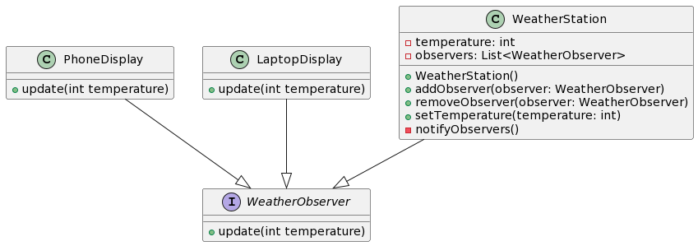
RealWorld2 Example Implementation
Consider a scenario where the View needs to constantly update based on changes in the Model. In traditional MVC, the View observes the Model for any updates and refreshes itself accordingly. However, in large-scale applications or situations where multiple Views depend on the same Model, this bidirectional communication can become cumbersome and may lead to performance issues or tight coupling between the components.
To address this problem, you can implement the Observer pattern or use variations like the Publisher-Subscriber pattern.

Slide 10
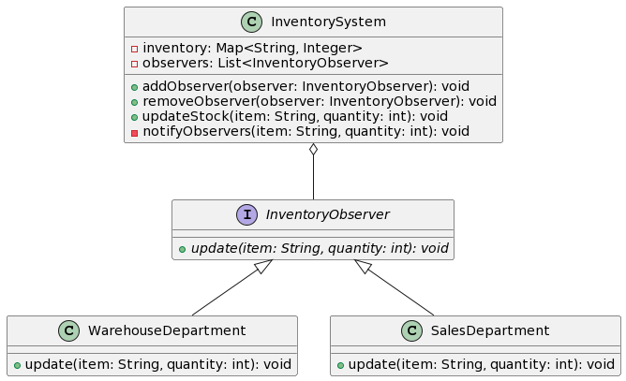
RealWorld3 Example Implementation
let's consider a scenario of an inventory management system. In this case, the Model will be an inventory system that notifies various departments or sections whenever the stock of a particular item changes.

Slide 11
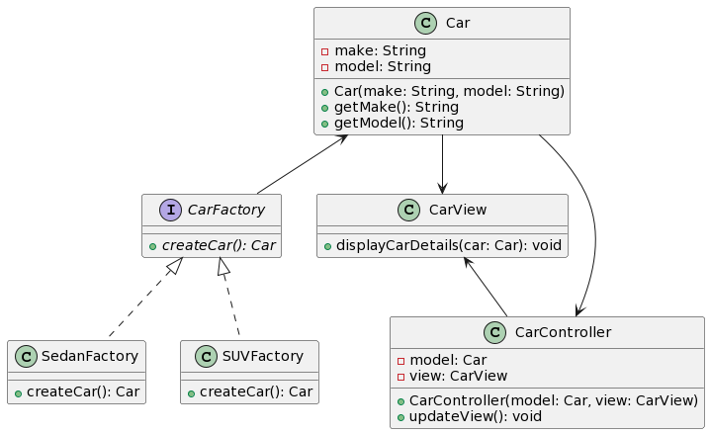
RealWorld4 Example Implementation
MVC pattern with the Factory Method pattern in the context of a car dealership application. The MVC pattern will manage the user interface and interactions, while the Factory Method pattern will handle the creation of different car models.

Slide 12
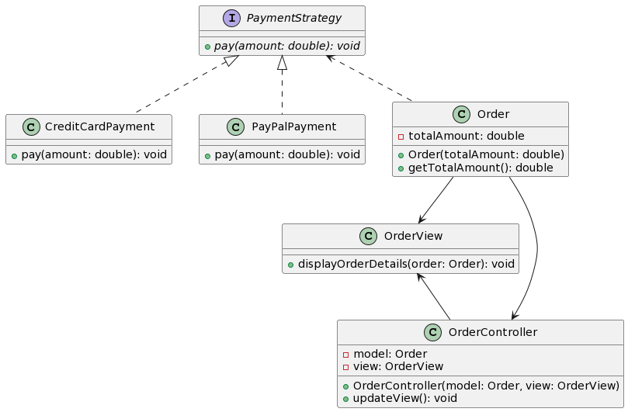
RealWorld5 Example Implementation
combining the MVC pattern with the Strategy pattern in the context of an e-commerce application. The MVC pattern will manage the user interface, and the Strategy pattern will facilitate different payment methods.

Slide 13
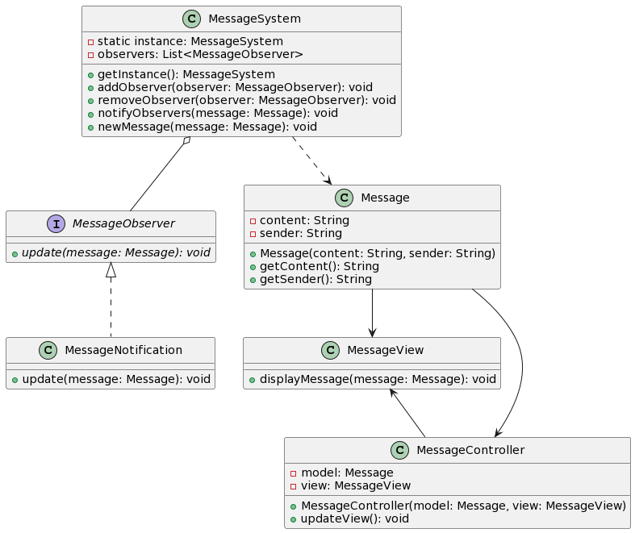
RealWorld6 Example Implementation
combining the MVC pattern with the Observer pattern and the Singleton pattern in the context of a messaging application. The MVC pattern will handle the user interface, the Observer pattern will manage the notifications for new messages, and the Singleton pattern will ensure a single instance of the messaging system.

